Slide 1

Thermal Microgrids: A New Opportunity for Municipalities, Universities, and Corporate Campuses to Reduce Energy Costs and Emissions
May 17, 2018
Funding provided by:
Notes:
The transcript to the May 17, 2018 webinar is included in the notes section of each slide.
Speakers:
Aimee Bailey (abbv. AB), EDF Innovation Lab
Sonika Choudhary (abbv. SC), City of Palo Alto Utilities
Joseph Stagner (abbv. JS), Stanford University
-------------
AB: Welcome everyone. This is Aimee Bailey, from EDF Innovation lab. Thank you for joining this webinar on Thermal Microgrids: A New Opportunity for Municipalities, Universities & Corporate Campuses to Reduce Energy Costs & Emissions.

Slide 2
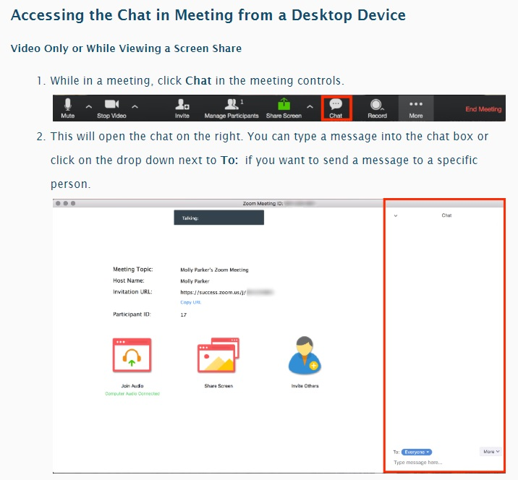
Webinar FAQ
The webinar recording and slides will be e-mailed to registered attendees within one week of the event
Please submit questions in the chat window, as shown in figure at right
Questions will be answered during a dedicated Q&A at the end
Accessing Chat Function in a Zoom Meeting
Notes:
AB: First, a few notes on webinar administration. We are recording the webinar. Links to the recording and slidedeck will be e-mailed to registered attendees within a week from today. During the webinar, please submit questions in the chat window and we will answer all questions during a dedicated Q&A at the end. If you are connecting by desktop, directions to access the chat window are shown at the right.

Slide 3
Today’s Webinar
Agenda
Description | Presenter | Duration
Project Introduction & Context | Sonika Choudhary, City of Palo Alto Utilities | 5 min
Thermal Microgrids: Technology, Economics & Opportunity | Aimee Bailey, EDF Innovation Lab | 20 min
Stanford Case Study | Joe Stagner, Stanford | 20 min
Project Next Steps | Aimee Bailey, EDF Innovation Lab | 5 min
Q&A |  | 10 min
Notes:
AB: Here is the agenda for today’s webinar.

Slide 4
Today’s Webinar
Agenda
Description | Presenter | Duration
Project Introduction & Context | Sonika Choudhary, City of Palo Alto Utilities | 5 min
Thermal Microgrids: Technology, Economics & Opportunity | Aimee Bailey, EDF Innovation Lab | 20 min
Stanford Case Study | Joe Stagner, Stanford | 20 min
Project Next Steps | Aimee Bailey, EDF Innovation Lab | 5 min
Q&A |  | 10 min
Notes:
AB: First, we’ll hear from Sonika Choudhary from City of Palo Alto Utilities, who will provide an introduction and context to the project.

Slide 5
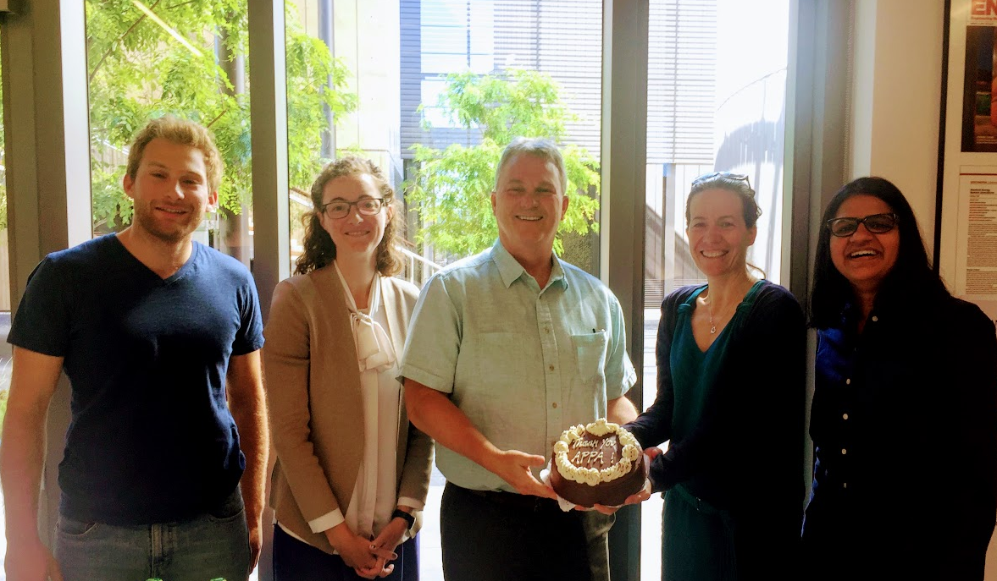
Thank you, APPA!
APPA’s Demonstration of Energy & Efficiency Developments (DEED) grant to the City of Palo Alto Utilities
“Leveraging Experience from Stanford and EDF to Develop Information and Tools for Thermal Microgrid Feasibility Assessments”
https://www.publicpower.org/periodical/article/palo-alto-utilities-thermal-microgrid-project-funded-through-deed-grant
Project Team Members:
Stanford EDF Innovation Lab City of Palo Alto Utilities
Joe Stagner Aimee Bailey Sonika Choudhary
Jacques Adrian de Chalendar Stephanie Jumel Shiva Swaminathan
Notes:
SC: We would like to thank our project sponsors, APPA, American Public Power Association, and their support for this project through their DEED grant. The City of Palo Alto Utilities is a small municipal utility located right outside the Stanford University campus here in Silicon Valley. It provided us a great opportunity to collaborate with Stanford, as well as EDF Innovation Lab. You'll be hearing from the project sponsors shortly on the progress of this project.

Slide 6
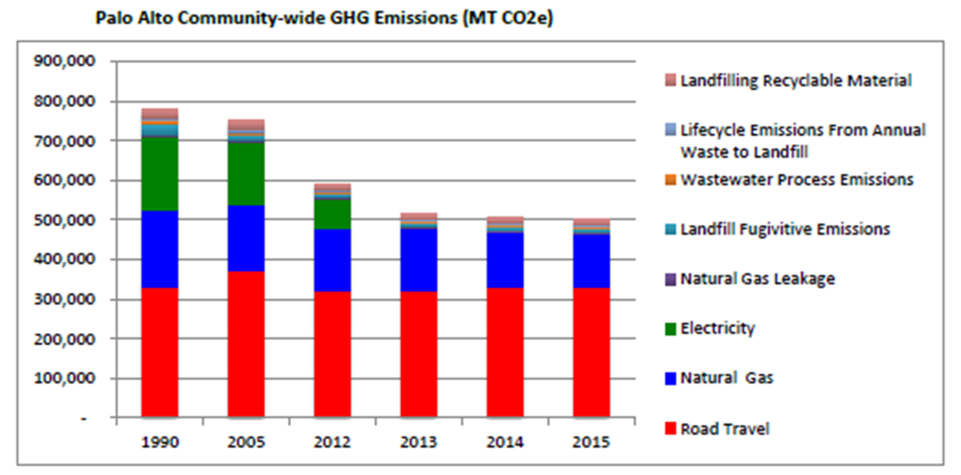
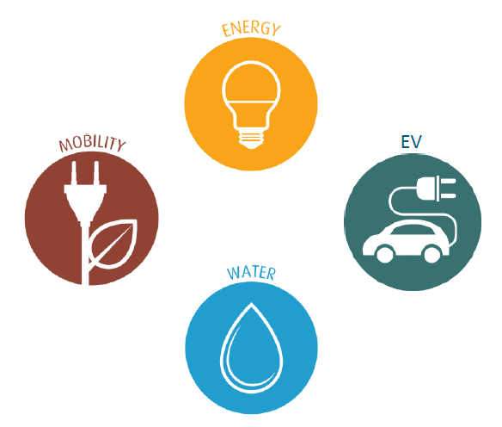
Palo Alto’s Sustainability and Climate Action Plan
Goal of 80% Greenhouse Gas (GHG) reduction by 2030
Sustainability Implementation Plan (2018-2020)
Transportation and building electrification are key focus areas to achieve 2030 goal
Notes:
SC: Palo Alto has very aggressive greenhouse gas reduction goals. Our city county adopted in 2016 that by 2030, we want to reduce our greenhouse gas emissions by 80%. To achieve these goals, emissions from road travel or transportation sector, as well as emissions from natural gas, which are represented in the red and blue colors in this graph of our annual emissions for many years. Those are two important components of our emissions for the City. This project provided us a great opportunity to explore the thermal microgrid concept for the building electrification. With that, I'll pass it back to Aimee for the presentation on this concept.

Slide 7
Today’s Webinar
Agenda
Description | Presenter | Duration
Project Introduction & Context | Sonika Choudhary, City of Palo Alto Utilities | 5 min
Thermal Microgrids: Technology, Economics & Opportunity | Aimee Bailey, EDF Innovation Lab | 20 min
Stanford Case Study | Joe Stagner, Stanford | 20 min
Project Next Steps | Aimee Bailey, EDF Innovation Lab | 5 min
Q&A |  | 10 min
Notes:
AB: Thanks, Sonika. I’ll lead the next section.

Slide 8


Thermal Microgrids: Technology, Economics & Opportunity
Project Deliverables
Part 1: White paper describing the technology, economics & opportunity
Part 2: Case study describing Stanford Energy System Innovations (SESI)
Part 3: Suite of tools for assessing technical and economic feasibility
Part 4: Municipal case studies carrying out feasibility assessments
Subject of today’s webinar
Notes:
AB: Our APPA-funded project has four total deliverables, shown here. This webinar covers the first two. The first is a white paper providing an overview of thermal microgrids, including a description of the technology, economics & opportunity. The second is a case study of Stanford’s energy system, which is the inspiration behind this entire project. Our presentations today are based on two written reports, shown here. The follow-up e-mail will provide links to the full reports.

Slide 9






Thermal Microgrids: Technology, Economics & Opportunity
Summary of White Paper
Audience: Staff at municipal utilities & similar organizations
Key questions:
        What is a “thermal microgrid”?
        What are the advantages and disadvantages of thermal microgrids compared to alternatives?
        What are the costs, GHG emissions impacts and water usage requirements compared to alternatives?
        What are the primary feasibility drivers?
        What is the potential of this technology in the U.S.?
        What business model structures could a municipal utility use for delivering thermal services via a thermal microgrid?
Peer Reviewers
Thank you to the following industry experts for their peer review:
  Jeff Byron, Former California Energy Commissioner
  Keith Dennis, Nat’l Rural Electric Cooperative Assoc.
  Bertrand Guillemot, Dalkia (EDF Group)
  Jerry Schuett, Affiliated Engineers
  Robert Turney, Johnson Controls
  Joe Vukovich, Natural Resources Defense Council
Notes:
AB: For a bit more context, the intended audience of the white paper is staff at municipal utilities, or similar organizations such as co-ops, CCAs, investor-owned utilities, local government staff that may not have an electric utility. The key questions it addresses are shown here. We put the draft white paper through a peer review process, and we’d like to thank the following industry experts for their feedback. The white paper will be finalized after incorporating feedback from all other stakeholders, including you: the webinar participants.

Slide 10
Thermal Microgrids: Technology, Economics & Opportunity
Energy & Environmental Policy Context
Within the U.S., buildings are responsible for approximately 40% of energy usage and one third of emissions
A significant portion is due to burning natural gas for space and water heating
Studies support achieving deep decarbonization requires fuel switching in the building sector from fossil fuel to electricity (aka “electrification”), along with continued energy efficiency and electricity decarbonization
Electrification policies gaining traction – current focus on building-level appliance switch-out
An alternative approach is to electrify an entire district
References: U.S. Energy Information Agency; U.S. Environmental Protection Agency’s “Inventory of U.S. Greenhouse Gas Emissions and Sinks: 1990–2015”; Williams, J.H. et. Al., The Technology Path to Deep Greenhouse Gas Emissions Cuts by 2050: The Pivotal Role of Electricity, Science, Volume 335, January 6, 2012; etc.
Notes:
AB: As many on the call know, in the US buildings are responsible for approximately 40% of energy usage and one third of emissions. A large portion of this is from burning natural gas for space and water heating. Studies looking at technical pathways to achieve deep decarbonization have found it requires substantial fuel switching in buildings, away from natural gas toward electricity, along with continued energy efficiency and electricity decarbonization. Electrification policies are gaining traction, although the current focus is on building-level appliance switch-out. An alternative approach is to electrify an entire district, using a district energy system.

Slide 11
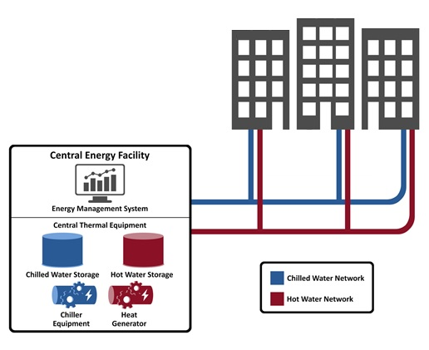
Thermal Microgrids: Technology, Economics & Opportunity
District Energy
District energy systems are networks of underground pipes carrying steam or hot (cold) water used to heat (cool) buildings.
Advantages of a district energy approach include:
Economies of scale from aggregating a collection of loads from dozens of buildings
Waste heat recovery technologies that are not available or efficient at a building-level
Load and resource diversity enabling optimized central equipment sizing and resultant enhanced efficiency
References: District Heating and Cooling, Svend Frederiksen and Sven Werner (2013)
Notes:
AB: District energy systems are networks of underground pipes carrying steam or hot or cold water used to heat or cool buildings, as depicted in the graphic at right. Another term for “district energy” is a “local energy system”. There are several advantages to district energy, including economies of scale from aggregating the energy needs from a cluster of buildings, some waste heat recovery technologies or approaches may not be available or viable at a single-building scale, and combining load and resource diversity enables you to optimize equipment sizing and enhances overall system efficiency.

Slide 12
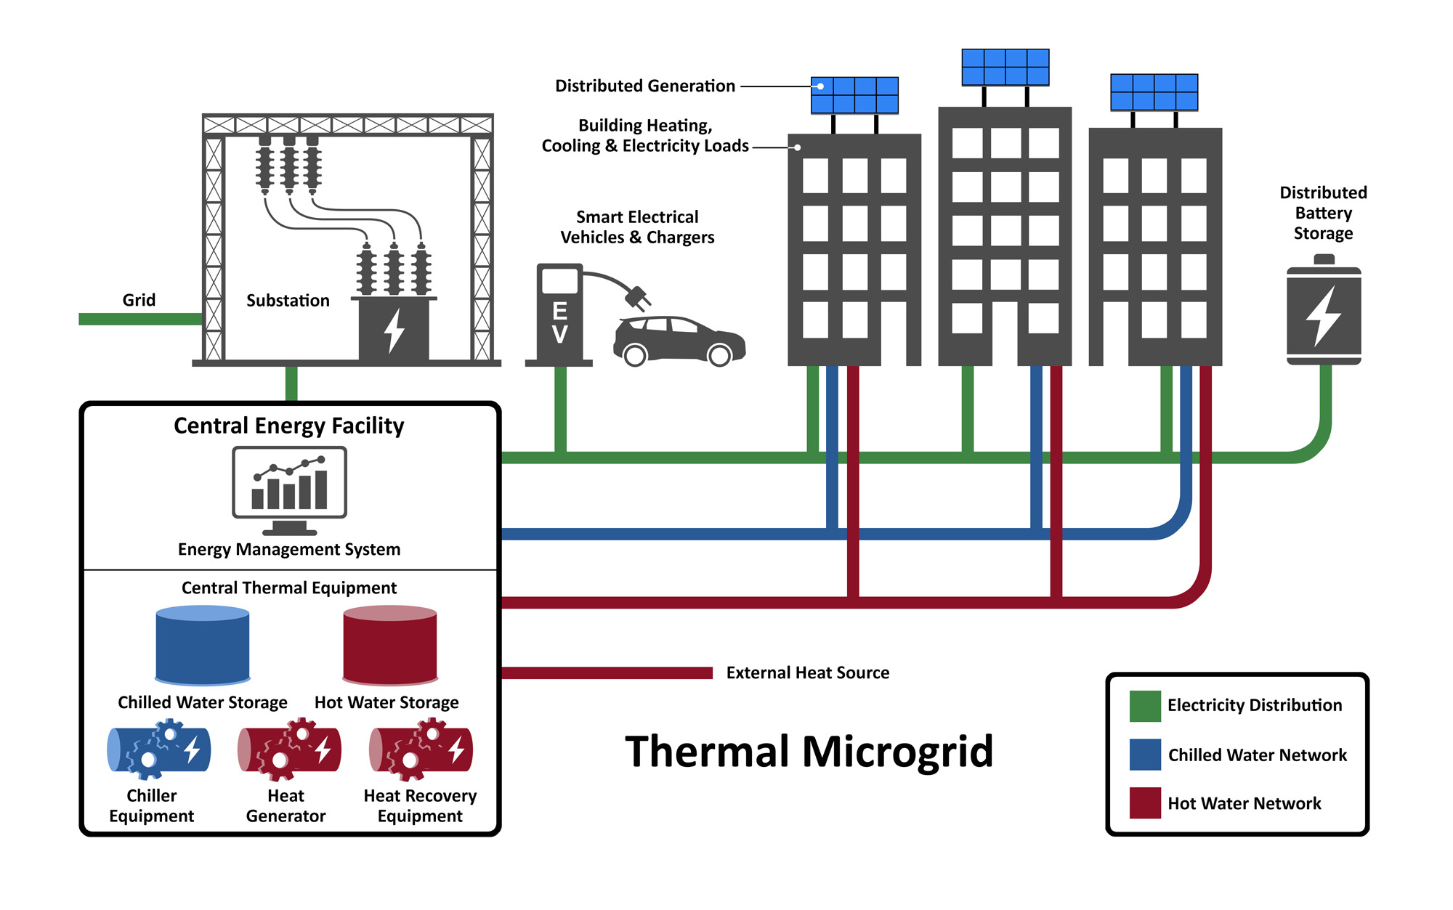
Thermal Microgrids: Technology, Economics & Opportunity
What Is a “Thermal Microgrid”?
A thermal microgrid utilizes energy efficiency; renewable electricity powered heat
recovery; thermal storage; and, advanced analytics and controls to provide co-optimized power and thermal services to a group of interconnected and controllable energy loads
within a defined boundary.
Notes:
AB: This project focuses on a specific type of district energy system, what we’re calling a thermal microgrid. We define it as follows: A thermal microgrid utilizes energy efficiency; renewable electricity powered heat recovery; thermal storage; and, advanced analytics and controls to provide co-optimized power and thermal services to a group of interconnected and controllable energy loads within a defined boundary. Similar concepts have been introduced before, including “renewable district energy”, “4th generation district heating”. The primary differentiators of this type of system are that: the system uses heat recovery as the primary heat source, as opposed to burning fossil fuel; it is a localized energy system that incorporates multiple energy carriers, such as electricity, heating and cooling as shown in this figure; and, the entire system is optimized over all energy carriers. We use the term microgrid to emphasize all the benefits associated with traditional electricity-focused microgrids, such as local energy utilization, enhanced community resilience and reliability, systems-optimized control and dispatch, and the ability to meet critical loads during larger grid disturbances. The adjective thermal in “thermal microgrid” is added to denote that the microgrid also incorporates thermal services such as hot water, steam, and/or chilled water, in addition to electricity. As mentioned before, this concept is inspired by Stanford’s energy system.

Slide 13
Thermal Microgrids: Technology, Economics & Opportunity
Trends Driving Interest in Thermal Microgrids
The same three trends driving the transformation of the entire energy sector are responsible for increasing interest in thermal microgrids:
  Decentralization. Increasing adoption of behind-the-meter solar, smart thermostats and other building energy management devices enabled by exponentially decreasing costs and novel business/financing structures are leading to a decentralized grid paradigm.
  Decarbonization. Local and state governments across the U.S. have adopted climate goals and corresponding energy policies and regulations to promote decarbonization of the energy sector.
  Digitization. Increased deployment of low-cost sensors, advanced control technologies, and artificial intelligence is fundamentally changing every facet of the energy sector.
Reference: https://energy.stanford.edu/from-directors/nurturing-innovation-during-strategic-inflection-point-global-energy
Notes:
AB: The same three trends that are disrupting the entire energy sector more broadly are responsible for increasing interest in thermal microgrids. Specifically, decentralization, decarbonization, and digitization, all of which are prominent features or attributes of thermal microgrids. Decentralization refers to the transition to a decentralized grid paradigm. Decarbonization is moving from a fossil-fuel based energy system to one that is sustainable. And digitization is the increased deployment and utilization of sensors, control and AI.

Slide 14
Thermal Microgrids: Technology, Economics & Opportunity
Goals & Objectives of Local Energy System Development
There are typically several considerations for local energy system deployment:
  Economics
  Environmental Impact
  Reliance on Fossil Fuel
  Local Control
  Reliability & Resiliency
  Water Usage
  System Flexibility
  Local Economic Development
  Stakeholders must first identify and prioritize goals to evaluate a thermal microgrid vs an alternative energy system design
Notes:
AB: When evaluating whether a local energy system is a viable option for a community, there are several sometimes competing considerations, a subset of which are shown here. In order to evaluate a thermal microgrid versus alternatives for their community, stakeholders in the community must first identify and prioritize their goals and objectives.

Slide 15
Thermal Microgrids: Technology, Economics & Opportunity
Opportunity
Public power uniquely positioned to lead thermal microgrid exploration and development:
Local energy system design choices often result in tradeoffs/synergies with other utility services & munis often have several, in addition to electric power
Munis can standardize interconnection procedures and develop innovative policies and rate structures to harness value of flexible and controllable load
Successful deployment requires ability to navigate complex, multi-stakeholder processes to achieve community goals – munis have decades of relevant experience
Historically, munis have shown leadership on environmental issues given the direct accountability to communities they serve
Notes:
AB: Public power, or munis for short, are uniquely positioned to lead. For instance, electric and thermal utility services can achieve cost savings across an electric and thermal utility through coordinating trenching. Munis are in a position to standardize interconnection procures and develop innovative policies to harness value. Successfully deploying such a system requires the ability to navigate complex, multi-stakeholder processes, which munis have decades of relevant experience doing. And, historically, public power has shown leadership on environmental issues.

Slide 16

Thermal Microgrids: Technology, Economics & Opportunity
Technology Description
Thermal microgrids incorporate several categories of technologies, including:
one or more heat and cooling sources and central equipment
one or more clean power generation systems, either located on-site or remotely
a thermal network of pipelines leading to delivery points referred to as substations, with a secondary network of pipes feeding end users
building interconnection equipment to couple the thermal network to the heating and cooling systems located at the customer site
1
1
Notes:
AB: Now, I’ll go through an overview of the technology. There are four main components to a thermal microgrid. First, there is the heating and cooling sources, including thermal storage.

Slide 17
Thermal Microgrids: Technology, Economics & Opportunity
Heat Sources
Low Grade Heat | Waste Heat Recovery From Buildings. Stanford’s state-of-the-art system uses the overlap in heating and cooling needs by capturing waste heat from the cooling network return pipe. Waste Heat Recovery from Municipal Wastewater (50-80 °F). Sewage is a heat source that is available in almost every community. A few degrees of heat can be extracted before or after sewage treatment. Shallow Geothermal (50-80 °F). Shallow geothermal (aka geoexchange) is the recovery of heat from within several yards of the earth’s surface, where the temperature remains relatively constant. Shallow geothermal as a heat source is becoming increasingly common for district energy systems. Other Waste Heat Recovery Opportunities. There are a variety of other sources of waste heat, a largely untapped potential energy source, including air- and water-source heat.
High Grade Heat | Waste Heat Recovery from Industrial Processes (200-1,800 °F). Waste heat from industrial processes is commonly available, varying in temperature from extremely hot process industry flue gases down to lower temperature refrigeration exhaust. Deep Geothermal (150-350 °F). Recovering geothermal heat requires deep boring into the ground. When economically feasible, deep geothermal offers a renewable heat source for base load needs. Waste Heat Recovery from Municipal Waste Incineration (130-300 °F). The combustion of municipal waste to provide electricity and/or heating (aka waste-to-energy) has been practiced in Europe for many years. Biomass (130-300 °F). Biomass can be used as fuel for large boilers or for CHP plants, a common choice for district energy systems. Biomass can also be used within existing fossil-fueled boilers as a co-firing to reduce emissions. Solar Thermal (175-275 °F). Solar energy can either augment existing heat sources in a thermal network, or feed a stand-alone system incorporating thermal storage to provide thermal heating year-round.
Notes:
AB: A variety of low and high grade heat sources could be used, which will depend on the location of the system and availability of resources. The focus of thermal microgrids are heat recovery opportunities, a large untapped source is waste heat recovery from buildings, which is the focus of Stanford’s system, which you’ll hear more about in a bit.

Slide 18
Thermal Microgrids: Technology, Economics & Opportunity
Cooling Sources
 | Heat Recovery Chillers (HRCs) in a Heat Network. As illustrated by Stanford’s system, cooling can be produced from a heat network using large HRCs located at a central plant. Absorption Heat Pumps/Chillers with a Heat Source. A heat source can be used to produce chilled water using absorption heat pumps/chillers, either located at the building site or at a central plant. Alternatively, a centralized trigeneration system utilizing similar equipment can produce a separate cold supply to serve a district, in addition to power and heat. Surface Water (40-75 °F). Also known as hydrothermal, lakes, rivers and oceans can be used as cooling source. Some systems use surface water not just as a cooling source, but in a combined scheme to prepare or provide potable water supply.
Notes:
AB: There are also a variety of ways to produce cooling for a district energy system, by combining heat sources with heat pumps, or from surface water.

Slide 19
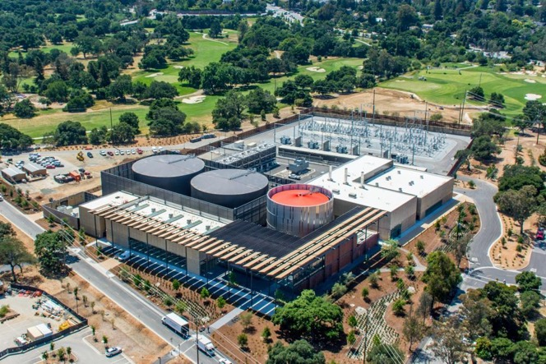
Thermal Microgrids: Technology, Economics & Opportunity
Thermal Storage
Central thermal storage enables optimized system operation of a thermal microgrid
Incorporated into the overall energy system design, thermal storage:
  increases the amount of heat recovery potential that can be used
  enables electricity load shifting from on-peak to off-peak periods
  enhances reliability and resilience by during grid disturbances
  reduces chiller capacity requirements
Hot and chilled water are the most common forms of hot and cold storage, although ice or ice slurry can be used as cold storage
Figure: Stanford’s Central Energy Facility, Showing Its Chilled and Hot Water Storage Tanks
Notes:
AB: And, in addition to the heating and cooling sources, central thermal storage is a technology that can be incorporated into the system design to cost-effectively increase heat recovery, load shift to off-peak periods, enhance resiliency and reduce the capacity requirements of the other central equipment.

Slide 20
Thermal Microgrids: Technology, Economics & Opportunity
Technology Description
Thermal microgrids incorporate several categories of technologies, including:
one or more heat and cooling sources and central equipment
one or more clean power generation systems, either located on-site or remotely
a thermal network of pipelines leading to delivery points referred to as substations, with a secondary network of pipes feeding end users
building interconnection equipment to couple the thermal network to the heating and cooling systems located at the customer site
2
2
Notes:
AB: Second is the power source, either located remotely or on-site.

Slide 21
Thermal Microgrids: Technology, Economics & Opportunity
Technology Description
Thermal microgrids incorporate several categories of technologies, including:
one or more heat and cooling sources and central equipment
one or more clean power generation systems, either located on-site or remotely
a thermal network of pipelines leading to delivery points referred to as substations, with a secondary network of pipes feeding end users
building interconnection equipment to couple the thermal network to the heating and cooling systems located at the customer site
3
Notes:
AB: Third, is the thermal network, or distribution network from the central energy facility to the buildings. This is the analog to the distribution system in the electricity sector.

Slide 22

Thermal Microgrids: Technology, Economics & Opportunity
Thermal Network
A thermal network is the distribution network of pipes, substations, valves and controls to deliver steam, hot water or chilled water from a central energy facility to end customers.
District energy has an advantage over building-level approach when cost savings of the central vs building-level equipment is greater than costs of distribution network
Three types of thermal networks, shown at right:
  A heat network supplies required heating and can provide cooling at the building via absorption chillers.
  A cooling network supplies required cooling and can also provide heat at the building via heat pumps.
  A tempered water system provides heat or cooling supply directly to the building.
Like an electricity grid, thermal networks have network operators to control outgoing water temperature and regulate flow to ensure all customer needs are met
Notes:
AB: A thermal network is the distribution network of pipes, substations, valves and controls to deliver steam, hot water or chilled water from a central energy facility to end customers.

Slide 23
Thermal Microgrids: Technology, Economics & Opportunity
Technology Description
Thermal microgrids incorporate several categories of technologies, including:
one or more heat and cooling sources and central equipment
one or more clean power generation systems, either located on-site or remotely
a thermal network of pipelines leading to delivery points referred to as substations, with a secondary network of pipes feeding end users
building interconnection equipment to couple the thermal network to the heating and cooling systems located at the customer site
4
Notes:
AB: The fourth component is building interconnection equipment to couple the thermal network to the building heating and cooling system.

Slide 24
Thermal Microgrids: Technology, Economics & Opportunity
Building Interconnection Equipment
The thermal network can interconnect with customer buildings in two ways:
  Direct Connection. The district energy system’s supply (i.e. steam, hot water or chilled water) is directly pumped through the customer’s building heating and cooling equipment (e.g. radiators).
  Indirect Connection. The district energy system is coupled to the building via heat exchangers used to transfer heat between the supply and the customer’s building system, keeping the supply isolated from the building heating and cooling system.
Controls, heat meters, and isolation valves & filters are installed for network balancing, billing and equipment protection, respectively
Notes:
AB: There are two ways to interconnect a thermal network with a building. First, a direct connect, where the energy carrier is pumped directly through the building heating and cooling equipment. The other type of interconnection is an indirect connection, where the thermal network is coupled to the building via a heat exchanger. Typically lumped together with the interconnection equipment are any controls, heat meters, isolation valves and filters.

Slide 25
Thermal Microgrids: Technology, Economics & Opportunity
Overview of Project Economics
Thermal microgrids are a major infrastructure project with substantial fixed project costs
However, they may lead to significant offsets: costs that would have been incurred if maintaining the existing energy system (e.g. expensive electric transmission and distribution system upgrades)
Costs can be broken down into the following categories:
  Primary fixed costs. Central equipment, thermal network and building interconnection costs
  Primary variable costs. Electricity/fuel and operations & maintenance (O&M)
  Other costs. Project development, customer acquisition, metering, billing, customer service & administration
Costs depend strongly on local conditions and project details
Notes:
AB: Like other major infrastructure projects, thermal microgrids have substantial fixed up-front costs. Nonetheless, the system may lead to substantial offsets: costs that would have been incurred by maintaining the existing system, such as transmission or distribution system upgrades. The three main cost categories are shown here. The final costs will depend, of course, on the final system design, local conditions and other project details.

Slide 26
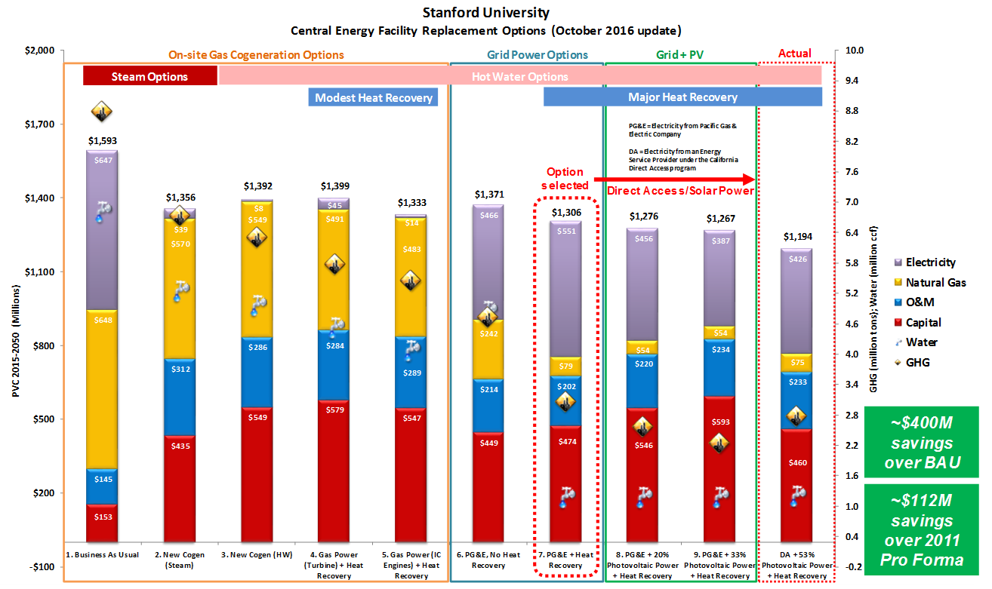
Thermal Microgrids: Technology, Economics & Opportunity
Comparison of Project Economics Across System Design
Notes:
AB: For illustration, this figure summarizes the results of the economic assessment of multiple central energy replacement options from the Stanford Case Study. Along the horizontal axis are all system design options considered, categorized by power source, heat network, and level of heat recovery. On the left vertical axis is present value costs in millions over the anticipated 35-year system lifetime (2015-2050). Costs are broken down by four sources: electricity, natural gas, O&M, and capital. Water usage and GHG emissions are plotted along the right vertical access to reflect the environmental impact of each system design option. This figure is specific to Stanford’s detailed evaluation of replacement options for their cogen plant, but the relative trends between energy system design options are transferable to other locations.

Slide 27
Thermal Microgrids: Technology, Economics & Opportunity
Drivers of System Feasibility
Key feasibility drivers include:
  Load density. The thermal network is a major source of project costs: the closer the buildings and the denser the load, the more cost-efficient the thermal network will be. IEA estimates a region can be served economically with district energy if heating load density is >0.93 kWh per square foot.
  Cost of heating and cooling supply. Advanced heat recovery enables low cost source heat for a thermal microgrid design. Regions near data centers or other sources of industrial waste heat could capitalize on this proximity.
  Load diversity. Sizing each individual building for annual peak is more expensive than sizing a cluster of buildings with load diversity. Advanced communications and controls to operate the resources and loads of the thermal microgrid can capitalize on load diversity and further enhance efficiency gains.
Notes:
AB: The primary feasibility drivers include the following. First is load density. The thermal network is expensive, so the closer the buildings and the denser the load, the most cost-efficient it will be. Second is the cost of heating and cooling supply. Advanced heat recovery enables low cost source heat in the thermal microgrid design. And another feasibility driver is load diversity, where the greater the load diversity the greater the potential for optimization across the local energy system.

Slide 28
Thermal Microgrids: Technology, Economics & Opportunity
Assessment of Potential in the U.S.
Many types of regulations would serve to promote thermal microgrids, including carbon tax, cap-and-trade program, energy efficiency targets, and local air quality standards
Several non-technical barriers that could significantly inhibit thermal microgrid deployment:
  Lower familiarity with district energy and advanced waste heat recovery in the U.S.
  Parts of the value chain for district energy are under-developed in U.S.
  Complex, multi-stakeholder processes for energy infrastructure development
  Securing large initial investment
  Timing of building equipment replacement
  Economic and policy uncertainties over the long project lifetime
  Etc.
Comprehensive potential assessment is beyond the scope of the white paper, but the subject of ongoing R&D activity
Notes:
AB: There are a variety of existing energy and climate policies in various regions that would promote thermal microgrids, such as a carbon tax, cap-and-trade program, energy efficiency targets such as California’s doubling of energy efficiency by 2030, and local air quality standards. Nonetheless, there are also many non-technical market barriers, such as those shown here. A comprehensive quantitative potential assessment is the subject of ongoing work.

Slide 29



Thermal Microgrids: Technology, Economics & Opportunity
Utility Business Models for Thermal Services
District energy systems, like electricity and gas networks, are natural monopolies
Multiple utility business model choices for thermal services, similar municipal electric utility options
Ownership & governance examples:
  Enterprise fund and operational department within a university or local government
  Special district organizationally independent from existing local governments
  Community-owned non-profit cooperative
  Community-owned limited liability corporation
Metering & billing could be based on square footage or estimation of usage, based on common engineering standards – easiest and most straightforward
Notes:
AB: There are a variety of business models available for thermal services, similar to those in use for municipal electric utilities. For example, an enterprise fund and operational department within a university or local government, which is how Stanford and Palo Alto utilities are structured; special districts; cooperatives; and, a community-owned LLC. There are also non-municipal business models, as well, which are not listed here.

Slide 30

Thermal Microgrids: Technology, Economics & Opportunity
Conclusions
Decentralization, decarbonization & digitization driving transformation of energy sector
Same drivers encourage consideration of efficient district electrification
Stanford’s system demonstrates the potential of thermal microgrids for achieving a decarbonized, cost-effective and resilient local energy system
Several non-technical barriers challenge market transformation
Munis are in a unique position to lead
Notes:
AB: In conclusion, decentralization, decarbonization & digitization driving transformation of energy sector, and these same drivers encourage consideration of efficient district electrification. Stanford’s system demonstrates the potential of thermal microgrids for achieving a decarbonized, cost-effective and resilient local energy system. Nonetheless, there are several non-technical barriers challenge market transformation. Munis are in a unique position to lead the exploration and development of thermal microgrids.

Slide 31
Today’s Webinar
Agenda
Description | Presenter | Duration
Project Introduction & Context | Sonika Choudhary, City of Palo Alto Utilities | 5 min
Thermal Microgrids: Technology, Economics & Opportunity | Aimee Bailey, EDF Innovation Lab | 20 min
Stanford Case Study | Joe Stagner, Stanford | 20 min
Project Next Steps | Aimee Bailey, EDF Innovation Lab | 5 min
Q&A |  | 10 min
Notes:
AB: Now I’ll turn it over to Joe Stagner, from Stanford.

Slide 32
Building Energy- Scale
    Energy use in developed countries
    Electricity, Heating, and Cooling of structures
    40% of GHG emissions
Notes:
JS: Hi, this is Joe Stagner, Executive Director of Sustainability & Energy Management at Stanford. I'm going to repeat some of what Aimee said quickly and show you how our system works. We've transformed our small city of 30,000 to this new system. It's been operational for over 3 years. I had independent audits to prove the economics and performance of the system and it continues to run well. Repeating what Aimee told you, buildings are 40% of the energy consumed in the Western developed world, and a like share of emissions of greenhouse gases as well as other pollutants. Of that, electricity heating and cooling consumed by buildings, the vast majority - half to two thirds - is for heating and cooling. So many of the industry directions on energy efficiency in buildings and moving to electric microgrids are great, but we want to make sure people don't overlook the largest of all opportunities which is thermal. For instance at Stanford, we toiled for 10-20 years to achieve a 20% reduction in energy use in our buildings through building-side energy efficiency programs. And, in 5 years, we cut our energy use in half with this new thermal system. So energy efficiency in buildings is great, but revising the thermal system of how individual or buildings collected together in district energy, how that energy is supplied through the techniques we're going to show are faster and far larger an opportunity than energy conservation or electrical microgrids and related, and I'll show you why.

Slide 33

Pathways for Sustainable Building Energy
    Carbon Capture & Storage
    Carbon Fuel
Less efficient, much higher cost, not distributable
    Sustainable Bio-Fuel
Not scalable, usually higher cost
    Electrification + Renewable Electricity
Most efficient, lowest cost, scalable, distributable, flexible, sustainable
    Non-Carbon Fuel (H, N)
Less efficient, higher cost, not distributable
Notes:
JS: The other thing of note, in the last 10-15 years, as folks look to reduce carbon, it's become quite clear there are only three paths to sustainable building energy. We can continue to use carbon fuels but we have to do carbon capture and storage, or we have to use sustainable biofuels. Carbon capture and storage isn't effective. It's not cost-effective. The technologies aren't there and may never be there. Any of you who have looked at that know carbon capture and storage is only used in a dozen places in the world, most of which are oil fields where they re-inject carbon to push more oil out. They tried to build a giant carbon capture and storage clean coal plant in Kemper, Mississippi. It turns out to cost about 5 times as much as a new nuclear plant and still doesn't work. The opportunity or thought that somehow carbon capture is going to move down to a small scale like a district energy system or a house or a cogen plant serving a corporation, that's likely never going to happen. It's way too expensive. And even if someone does invent a machine that will capture all the carbon out of your smoke stack, trying to get that carbon somewhere where the carbon can be put in the ground safely forever, that's of course not very practical. So there's no catalytic converter that we can rely on to make our way out of using carbon in furnaces in our houses or boilers in our buildings. Sustainable biofuel is more practical. We can keep our carbon fuel combustion devices if we can feed them with clean fuel that's actually environmentally sustainable. But the scientists will point out that that's not scalable. On the global scale, there is simply not enough land on the planet to both grow food to keep our population fed, and grow crops, algae or anything else we can turn into biofuel. And it's far less efficient and more costly than putting a solar panel up or a wind mill. So we're not real high on the thought of trying to continue to use combustion of carbon fuels and capture and store the emissions or avoid them through sustainability. It's really not practical for all but very few people that can do sustainable biofuel. You've probably heard about the hydrogen highway - companies producing hydrogen fuel cell cars. If you produce hydrogen by using clean renewable energy to split hydrogen off of water using hydrolysis, then you have a sustainable energy system. But as it turns out, it takes twice as much renewable energy to split hydrogen off of water and use the hydrogen to drive a car, as it does putting renewable energy directly into a car. You can use one kWh to drive your Chevy Bolt or Nissan Leaf three miles, or you can use 2 kWh to have a clean hydrogen car go three miles. Hydrogen appears to be far more expensive and less efficient than just going with clean electricity. The potential homes for hydrogen are in devices, transportation that cannot be electrified, such as airplanes, ships, and long-haul trucking. So that's why the research continues in that, although Tesla has come up with a short-haul semi option. Apparently a long-haul semi still requires too big a battery that weighs too much to go great distances. So some compact form of sustainable fuel other than a battery may be the next best choice compared to belching out all the diesel. Hydrogen may be a solution for trucks. I don't know if it will ever be a solution for aircraft or not, and/or ships. That's why research continues around hydrogen. But I wouldn't factor in using it in all our regular transportation and our buildings. It's far less efficient and far more expensive than the middle option, which we did and which a lot of folks recognize is the best, and that's electrification plus renewable electricity. It's the most efficient, lowest cost, scalable. We already have a nationwide and worldwide distribution network to get electricity to almost every corner. And it's far more flexible because you can produce clean electricity so many ways today and there may be so many other ways in the future. In summary, clean electrification with renewable electricity is doable now. It can be done fast. It's the best long-term option as far as we can tell.

Slide 34






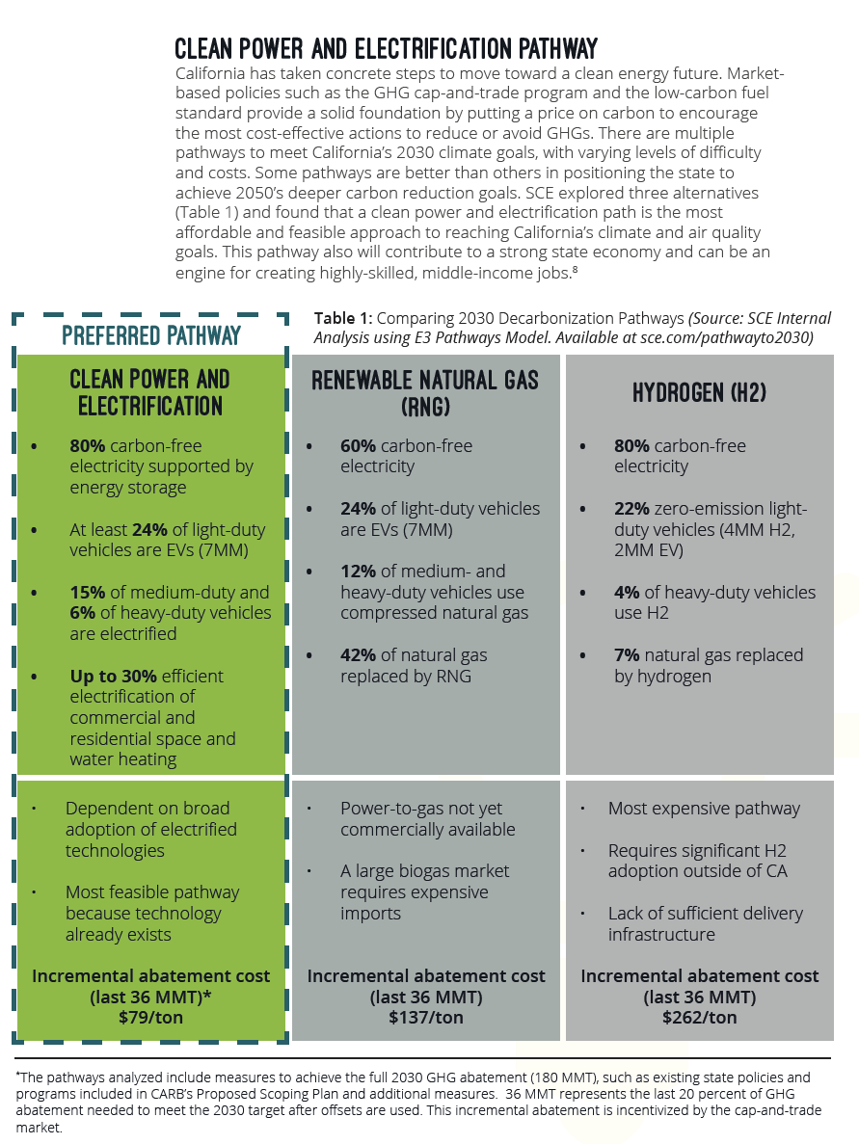
Stanford, IEA, National Labs, UN, SCE, and others agree about the clean electrification pathway:
2009
2011
2014
2015
2017
Notes:
JS: But don't take our word for it. In 2009 we reached this conclusion and developed our system which was approved by our board in 2011, and we started to build it and it's been operational for a few years. In 2011, the International Energy Agency came to the same conclusion that we need to heat and cool our buildings with clean electrification and heat pumps. Decarbonization studies sponsored by a number of institutions and performed by national labs came up with the same conclusion in 2014. United Nations, same conclusion in 2015. And, more recently, Southern Cal Edison in Nov. 2017 published their study of how they can help get to California's greenhouse gas emissions reduction goals. They looked at the same pathways: hydrogen, clean carbon and clean power and electrification. Their study shows clearly that clean electrification is by far fastest and cheaper.

Slide 35
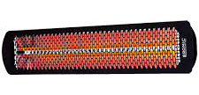
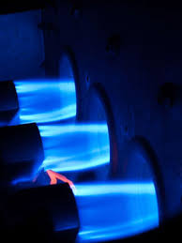
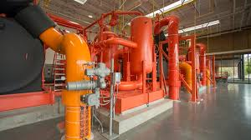
Heat Pump is Key to Building Electrification
    Electric Resistive
    6,816 btu of gas = 1 KWH = 3,413 btu of heat
    (50% efficient grid gas power plant)
    4,000 btu of gas = 3,413 btu of heat
    (85% efficient heater)
    Gas
    Electric Heat Pump
    1,133 to 2,040 btu of gas = .17 (120F) to .3 (160F) KWH
    = 3,413 btu of heat
    (50% efficient grid gas power plant)
Notes:
JS: Here is one of the reasons for that and one of the ways you can do it. We can make electricity clean and supply power to our buildings and then we have sustainable power and light. That's pretty easy. Most air conditioning is done with electric machines, so if you clean up the grid, you've got clean air conditioning, by and large. The real challenge for society is how to provide heating and hot water cleanly. Producing heat with natural gas is a lot more efficient if gas is the only fuel one had to use, than doing it with electricity. So on the top, you can see that if you were to use some of these electric radiant heaters or an electric water heater at your house or building, assuming you have a 50% efficient grid gas power plant, which is the nominal efficiency for electricity made with gas. As a lot of you know, a big part of our nation is using to natural gas powered electricity and renewables, natural gas being a big component. So if you put 6,800 BTUs of gas in a grid power plant, you get a kWh of electricity sent to your building, then that will make 3,413 BTU of heat. But if you instead of putting the gas in a grid gas power plant, you put it in a boiler or a furnace at your house or building, you can use 1/3 less gas and get the same amount of heat. So that's why there's not a lot of electric homes or buildings any more. If you're going to burn gas, you might as well burn a lot less and do it with a boiler furnace at your house. But the new thing that's even an order of magnitude better than that method is an electric heat pump. So going back to electricity, but instead of using electricity to make heat by just heating up a piece of metal, an electric heat pump can do it with 1/4 to 1/2 the energy of even the gas situation. The reason that is is because a heat pump, unlike the other two methods, does not transfer energy into heat. Rather, it consumes a little electric energy to take heat from one place, package it up in the form you need it, and deliver it to another place. So for instance your home air conditioner is an electric heat pump. It basically takes heat you don't want in your house in the summer, and it transfers it out the side of your house via the air cooled condenser. Big chillers at buildings have the exact same process. They take heat out of the building, and they put it out in an evaporative cooling tower. That also consumes water. Instead of wasting that heat through evaporative cooling towers or out the side of your house, what if we turned that heat into hot water that can be used for clothes washing, bathing, cooking, and for those buildings that need heat, heating. So, just a little extra electricity into that chiller, and you get what you call a heat recovery chiller. It's just like a regular chiller, it's just that instead of putting 95 degree water out to a cooling tower to get ride of it, it might make water that's 120-170 degrees that you can use in all modern building systems. So the electric heat pump is the key to unlocking electrification to this 40% building energy section for the world. That's why Stanford went to that.

Slide 36
Assessing Heat Recovery Potential- Stanford Example
Notes:
JS: So the next question is, I can use an electric heat pump but how much heat can I recover from my air conditioning process and then where do I get the rest of my heat? Let's talk first about the heat recovery process. These three charts show Stanford's typical heating and cooling profiles on a daily basis for summer, winter, and the in-between seasons of spring and fall. In the summer, you can see we have a lot more cooling in the daytime when the sun comes up than we do at night. We have a constant demand for heating and hot water for bathing and many other things. In winter, it's the opposite. Much more heat demand than cooling demand. And in-between in the spring and fall. The green areas show this overlap. If you think of a cooling system not as a system for delivering cold. It's really a system that collects heat. It's a system that collects unwanted heat and does something with it. Today we typically throw that heat away. This overlap is of a system that collects heat and one that delivers heat. So obviously if you're collecting a bunch of heat in your air conditioner or central plant, rather than throwing it all away, why don't you reuse as much as you can to meet your heating demand, and only throw away what you can't use. This green depicts that opportunity.

Slide 37
Stanford Heating & Cooling Load
Notes:
JS: If you look at it over the course of a whole year, here's what Stanford's cooling and heating profiles look like. Above the x-axis is our cooling demand profile. And you can see there is much more cooling in summer than winter. Likewise the red below the axis is our heating demand profile, and of course there's more in winter and less in summer.

Slide 38
Stanford Heat Recovery Potential
Use Heat Pump first for: 1) Heat Recovery, then 2) Heat Extraction from Ground, Water, or Air
1
1.4
Notes:
JS: When you do the overlap, you can see how much of that waste heat in blue that we had been throwing away in cooling towers, we could now turn into hot water and use to meet our heating loads. 53% of our waste heat supplies 88% of our annual total heating demand on campus now, meaning 88% of the fossil fuel that we used to burn in furnaces and boilers to make heat, we can now make with our electric heat pumps. And it's really a bi-product of something we need to do anyway which is cooling. So it's almost like free heat. There's a ratio of 1:1.4 because the heat you take in to throw away, the electricity that runs the machine to do that, the heat pump, is converted to heat as well, and added to the heat you were going to throw away, so you actually get about 1.4 units of available heat out for every 1 unit of waste heat you're trying to get rid of.

Slide 39
Types of Building Energy Supply Systems
Notes:
JS: For those of you familiar with basic energy systems especially at the district level, this is a reference diagram that explains the differences. There are the three services we need to do for buildings: heating, cooling and power. Now you've probably heard about cogeneration plants, or combined heat and power, that's diagrammed on the left. You put fossil fuel - natural gas in most places - into a cogeneration unit, which is typically a gas turbine, like a jet engine on a wing. It produces heat and electricity. You use some of the heat and electricity to drive steam or electric power chillers to do the cooling part. The trouble of that system and the system that Stanford used for twenty years is that it's all fossil fuel. It's a hundred percent fossil fuel. Typically, at your house or at many simple buildings you have what's called separate heat and power. At your house, you have a furnace that burns gas to make heat, indicated in the red box. You'll have an electric air conditioner that does your cooling, in the middle. And you'll get your electricity off the grid, in yellow. So you're getting your heat and power from separate sources. That's what's used anywhere where there is not a cogen plant typically in the country, from your house all the way to a district energy system. This new scheme we call combined heating and cooling is shown on the right. We get two products out of one piece of equipment, our heat recovery chiller. We get heating and cooling out of it. With a cogen unit, you put in fossil fuel and get heat and power. With a heat recovery chiller, you put in clean electricity and you get heating and cooling. And you have to get your power from somewhere else, but since you're getting all clean power from windmills, solar plants, etc., then the whole scheme is electrified and it's all supplied by clean electricity. And, it turns out, Aimee showed you our economic diagrams, and I could show you thermodynamic and energy efficiency diagrams, this system is far more efficient than any of the other systems including cogen. A lot of people in the country think it's still the most efficient way to do things. It's only because they don't know about combined heat and cooling. When you actually look at the figures, combined heat and cooling is far more efficient and that's because it does something that the cogen system doesn't do. It's reusing energy that the cogen system throws away. So all that heat that we took in in our cogen plant all year and threw away in our evaporative cooling towers, we are now using that. So, about 1/3 of our energy is now free and we don't have to burn gas to get it. So that's why the efficiency of the combined heat and cooling system or a thermal microgrid is untouchable from any other technology. And the fact that it's electric means it's a pathway to sustainability.

Slide 40
Basic Overall System Components
  Heat Pump (aka Heat Recovery Chiller)
  Chiller
  Boiler/Hot Water Generator
  Optional but highly desirable and cost effective
  Hot thermal energy storage (typically water)
  Cold thermal energy storage (typically water)
  Model Predictive Control software for planning, design, and operation
Notes:
JS: The basic overall components whether it's at your house or whether it's at a commercial building or district energy system - the central part is a heat pump, or heat recovery chiller. It's the same thing as a chiller, but it puts out a little more hot water than a chiller might. And then for that portion of air conditioning in summer where you don't have a place to use the heat because already 100% of your heat is being provided by your waste heat, you have even more waste heat because it's hot in the summer, well then you can throw away as we have thus far in evaporative cooling towers or inject it into the ground or what have you. You'll need a conventional chiller to do that because it uses electricity rather than a heat pump to do it. You don't have to turn up the heat to 170 degrees using a heat pump to send it to an evaporative cooling tower. You can use less energy to raise the temperature to 95 and throw it away. That's more efficient to use the chiller for throwing waste heat away than the heat pump. And then a boiler and hot water generator that supplies the balance of your winter heating that you can't provide through your own waste heat recovery. And typically you will want to put in enough capacity so that if the grid went down, and you didn't have your heat pumps to make heat, you could burn gas in your heater to make hot water and get you through that day or two. Optional and highly desirable to add to those three, you can have a system with just the top three and do just fine and make lots of efficiency and cost improvements for you and greenhouse gas and water reductions. But if you want to make it even better, hot water thermal storage, cold water thermal storage, and model predictive control software will help you get another 20-30% efficiency and cost savings and I'll explain how those work.

Slide 41
Stanford Central Energy Facility
Hot and Cold Thermal Energy Storage
  Reduces Capital & O&M cost
  Increases system efficiency (6% more heat recovery)
  Reduces electricity peak demand by 17% (36 v 43 MW)
  Provides equivalent of 7 MW electricity storage
Notes:
JS: Here's a diagram of the plant we constructed to do all the heating and cooling for Stanford. So, referring back to our heat recovery chart, you can see the goldenrod color in the middle, the heart of the system that does most of the work, we have three heat recovery chillers that do simultaneous heating and cooling. We have hot and cold water tanks so that we can store heat that can't be used in the day so that it can be used at night or later so we can have less total mechanical equipment and all the benefits of thermal storage that Aimee pointed out. And then we have our conventional chillers and hot water generators and cooling towers to handle that balance of blue and red you see on the chart that we can't do with heat recovery. Now to fully eliminate all gas use and increase the efficiency of any system like this, you can use those heat pumps in winter and suck heat out of the ground, a body of water or the air, if you don't want to burn gas to make that red part. We've designed a ground-source heat exchange system of wells we can put in the ground to circulate water to allow the heat recoveries to suck heat out of the ground in winter. And we're also exploring using our campus irrigation system and several small reservoirs, lakes and water on our property where we store water for irrigation, and that's probably going to be preferable as the place to exchange heat within summer and winter, and the ground source system will be secondary due to economics. That blue and red for us will be moving to full electrification as well, so we'll be 100% carbon free when we do that.

Slide 42
Model Predictive Control Software
  Increases system efficiency
  Reduces electricity peak demand and total cost
Notes:
JS: So this model predictive control software, think of it as autopilot for an aircraft. When you have a system like ours where you have hot and cold thermal storage, heat pumps that do both heating and cooling, chillers that do just cooling, and boilers or hot water generators - you have these five components that can all do work to meet your load. Humans can describe how to run those and meet load, but a computer can do it faster and more efficiently. So we developed this system where we can predict what the loads will be every hour for the next week at any time, based on what the forecast is, and pass information and energy use from our campus, and we pass information on what energy price will be - could be your electricity tariff if that's fixed, or you could be on the open market, what we call Direct Access power here - it's whatever we think the market prices are going to be. So we have algorithms to predict that. Once you put in what your loads are and what you think the prices of electricity are at what times of day, the machine then figures out the optimal way to dispatch or run this equipment, and when to take from thermal storage to meet your needs in the cheapest way possible.

Slide 43
Benefits of Model Predictive Control
Manual Operation
Computer Operation
Lower electricity peaks & commodity costs save $$$
    2016 full year Operators vs. Computer simulation conducted
    Benefits of computer optimization:
      Reduces peak demand on grid by 7.3 MW (35.9 MW vs 43.2MW)(17%)
      Saves $500,000 per year (10%) in CEF electricity cost
      Functions as ‘autopilot’ to run CEF
Notes:
JS: And we did a test where we had our control room operators showed how they would dispatch the plant to meet a year's worth of loads, and we compare that to how the computer would do it. On the left are the results. We have basically an electric system. The squiggly red line is how much electricity our buildings use. The orange line is how much more electricity we use to do our heating and cooling to run the energy plant. So you add the electricity the buildings use and the electricity the thermal plant uses and you get the electricity profile we present to the grid. The electricity we buy off the grid and the pattern for that. You can see on the right that the computer has a much more stable and lower peak profile, which actually uses 7.3MW less peak demand than if the humans did it. And it saves us about $500k a year in electricity costs or 10%. So this model predictive control software is great to use to plan systems and to operate them. It's a very quick payback of this software, and it increases reliability and saves a lot of money in applying advanced mathematics to do things that humans can do but not as good. A pilot can fly a plane from San Francisco to New York just fine, but autopilot can even do a little better.

Slide 44
Stand Alone vs. District Energy
  All concepts work at stand alone building level- residential on up
  But application via District Energy even better
  Application in new development even easier and more efficient
Notes:
JS: So as Aimee pointed out, systems like this work great in district energy. There's a lot of reasons why for cities, even residential in some places in Europe, to more dense building sectors like downtown, parts of cities and universities, district energy can do things more efficiently than having separate air conditioner and heater on every single building. It saves a lot of money on capital costs, allows for diversity of load. For instance, a building on one side of the street may have excess heat on one day, and a building on the other side of the street might be short of heat and be turning its heater on to make heat for itself. Well for a building across the street to get rid of its excess heat to be giving it to the building across the street, that saves burning fossil fuel. That saves money for everybody. That's just one basic feature for why district energy is such a good thing. These documents from the United Nations and others show why district energy is good and all the benefits. But again, all these concepts we've talked about you can apply at residences all the way through district energy.

Slide 45
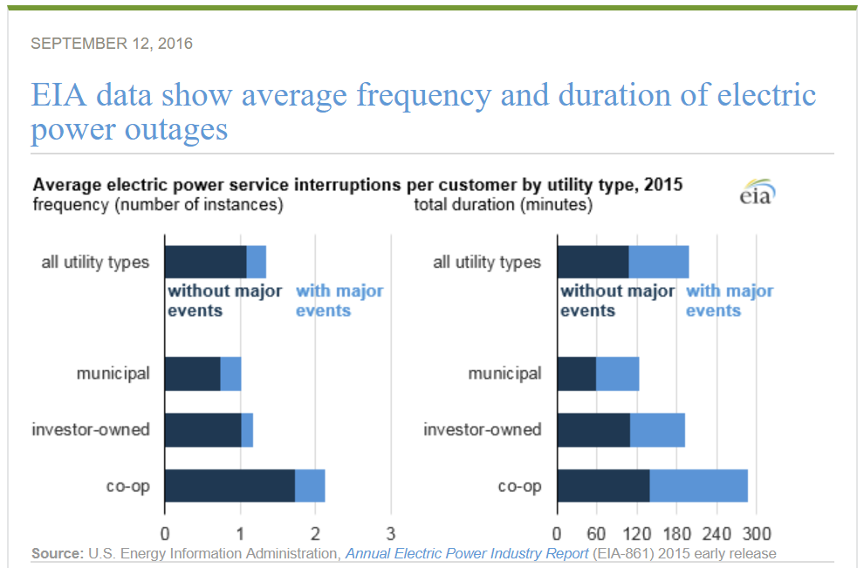
Reliability & Resiliency
  “The electrical grid is far more reliable out west than back east…we have outages all the time and can’t rely on the grid for something as essential as heating in winter”
  “Electrification & Heat Recovery only works in mild climates like Stanford’s…it won’t work in cold climates like the Midwest or East”
Heat Recovery (CHC) system has 4 sources of winter time heating energy:
Electricity (primary)
Thermal Storage (backup)
Natural Gas (backup)
Liquid Fuel (backup)
SHP and CHP systems
only have 2 sources:
Natural Gas (primary)
Liquid Fuel (backup)
Notes:
JS: A lot of folks when they saw our system, particularly those in colder climates, thought that this was a left coast Palo Alto thing, that it's only our mild California weather that allows us to do this sort of thing and that it would never work in New York or Chicago or some place cold. And that's really a myth, and we've proved that. It's a myth because if their main concern is that the grid goes down in an ice storm or a snow storm and it's freezing, how can we possibly stay warm with a heat recovery deal. The fact is, the grid only goes down a few hours per year in most places. There's lots of news stories when the grid goes out a day or two. But if you look at the federal government data on grid outages across the countries, you can see that it's only an hour or two every year. So why construct a system that you're going to operate the next thirty years to be 100% fossil fuel so that maybe once every ten or fifteen years, you have protection against a grid outage, when in fact a system like ours provides that same protection if not more. So we can make heat to keep our buildings warm four ways. We can use electricity 99.9% of the time, because that's when the grid's up and available, and it's more efficient and cleaner. If the grid goes down though, we have thermal storage. There is going to be some hot water in our water tank that could keep us going from a couple hours to a whole day, depending on when things happen. But even if those fail, I have everything a cogen plant or conventional system does. I have enough natural gas heaters and a big pipe of natural gas coming to our campus that I could heat continuously our campus with natural gas for as long as the grid's down. And our units also have liquid fuel in tanks, so that if the natural gas system goes down because say the grid was out of power and that stopped all the natural gas transportation pumps, well we can use liquid fuel. So we actually have four ways to make heat, whereas cogen and conventional systems only have two ways to make heat in cold climates. So it's a myth that a clean electricity based heating system is less efficient and less resilient in cold climates. It's actually more efficient and resilient.

Slide 46
Electrification makes sense in all climates
Notes:
JS: This also proves the fact that it's not just in mild climates where heat recovery works. Upper left is our heat overlap chart. The upper right is our Redwood City campus. Now we're in the same weather, right - mild climate - but it's a totally different type of building community. It's a Monday through Friday day shift only operation of administrative folks. So it's a much higher cooling demand over the summer than heating, since it's not open nights and weekends. Yet still, 57% of the total heat used by the facility over the course of the year will come from it's waste heat. Lower left is the University of Illinois. They use about twice as much energy as Stanford because they're bigger, and you can see their winter time cooling loads are dramatically bigger than Stanford's. And it's true that in the dead of winter, heat recovery cannot provide most of your heat. But it can provide all of your heat in summer and part of your heat in spring and fall, and an even smaller portion in winter. Over the course of the year, 55% of the heat consumed by the University of Illinois could be supplied by their own waste heat they're throwing away now. On the lower right is the University of California, Davis. They're in a climate that's much colder in winter and hotter in summer than ours. Again, 50%. When you look at these, it makes sense: everywhere in North America we have a summer surplus of environmental heat. and almost everyone is doing some form of air conditioning, which is collecting and throwing away heat. Why anywhere in summer we would burn fossil fuel to make hot water or washing clothes or anything, it makes no sense. We don't have to do that. And these charts reveal that that's the case everywhere.

Slide 47
Total Energy Micro-grid…thermal before electric
Notes:
JS: Final slide then reaffirms some of what I and Aimee have talked about. It's important to increase the efficiency of buildings and there's a lot of talk about electric microgrids and perfecting electric microgrids and this and that. But the lionshare of the opportunity for sustainability, efficiency and economic savings is in thermal microgrids. Taking that 2/3 of our total building energy that is done for heating and cooling and finding a way to do that more sustainable, and that's what these systems do. So this chart diagrams this concept. In pink is our thermal microgrid, our system. It considers electricity used by the buildings, but primarily most the savings are all in how we heat and cool and convert that into electricity. When we now add on-site PV, and we've added 5MW to our rooftops, we're starting to add more plug-in electric vehicles, and we've studied heavily electricity storage. Those typical components of the so-called electrical microgrid, they have value but they're not nearly the opportunity of the thermal microgrid. And the point is really that we should look at all of them, and look at a total energy microgrid: not just an electrical microgrid, and not just a thermal microgrid, which most people don't know about and what we're trying to share with you the importance of, but look at the whole thing. Thermal should come first, because it's the biggest opportunity. It's the fastest conversion. It's the most money to be saved, etc. But also do electrical and really think of it all together as a total energy microgrid, is our advice.

Slide 48
Today’s Webinar
Agenda
Description | Presenter | Duration
Project Introduction & Context | Sonika Choudhary, City of Palo Alto Utilities | 5 min
Thermal Microgrids: Technology, Economics & Opportunity | Aimee Bailey, EDF Innovation Lab | 20 min
Stanford Case Study | Joe Stagner, Stanford | 20 min
Project Next Steps | Aimee Bailey, EDF Innovation Lab | 5 min
Q&A |  | 10 min
Notes:
AB: Thanks, Joe.

Slide 49
Project Next Steps
Project Deliverables
Part 1: White paper describing the technology, economics & opportunity
Part 2: Case study describing Stanford Energy System Innovations (SESI)
Part 3: Suite of tools for assessing technical and economic feasibility
Part 4: Municipal case studies carrying out feasibility assessments
In Progress
There are two additional parts to the project, shown above
If you are a muni and interested in being the subject of the 2nd case study, please contact us
A second webinar will be organized in Fall/Winter 2018 covering final results from the project
Notes:
AB: For next steps, the project team has two more deliverables: a suite of tools to aid muni staff in assessing techno-economic feasibility of thermal microgrids for their service territory. And, applying the tools to a region of Palo Alto and a region of another municipal utility outside of California. We haven’t confirmed a second muni yet. If you are a muni and interested in assessing part of your service territory for a thermal microgrid, please contact us. Also, we will organize another webinar in the fall or winter of this year to share the final results from the project. Stay tuned.

Slide 50
Today’s Webinar
Agenda
Description | Presenter | Duration
Project Introduction & Context | Sonika Choudhary, City of Palo Alto Utilities | 5 min
Thermal Microgrids: Technology, Economics & Opportunity | Aimee Bailey, EDF Innovation Lab | 20 min
Stanford Case Study | Joe Stagner, Stanford | 20 min
Project Next Steps | Aimee Bailey, EDF Innovation Lab | 5 min
Q&A |  | 10 min
Notes:
AB: Now for Q&A.

Slide 51
Q&A and Contact Information
Q&A
Contact Information
Please type your questions into the chat window.
Sonika Choudhary Resource Planner City of Palo Alto Utilities sonika.choudhary@cityofpaloalto.org
Aimee Gotway Bailey, Ph.D. Principal Energy Analyst EDF Innovation Lab aimee.bailey@edf-inc.com
Joe Stagner, P.E. Exec. Director, Sustainability & Energy Management Stanford University jstagner@stanford.edu
Notes:
(Editor’s note: Large parts of Q&A section of webinar unintelligible from recording. Below are questions and answers based text history in the chat window and project team feedback.)
SC: Please unmute yourself or type your questions into the chat window.
Q1: First question: some of the results you have shown are kWh per square feet. Are these across Europe or US?
A1: (AB) I believe you’re referring to the estimates for how much load density is needed to justify the capital investment of a thermal network. The figure was from an International Energy Agency assessment based on a survey of studies and intended as rough estimate.
Q2: Another question: kWh per what period of time? Geographical area? A follow-up to last question.
A2: (AB) The figure is based on an average amount of load over the period of time of operation. It could be seasonal system that only operates in the summer or in the winter. Or, like the Stanford system, it could operate throughout the entire year. And, it is specifically for the geographic boundary that the thermal network will serve.
Q3: A question for Joe: What is the overall system efficiency and how has the system performed since commissioning?
A3: (JS) The only way you can compare the efficiency of a gas and electric system or a system based on gas, coal, electricity is to pick a common fuel. So we asked the question, if we were to burn natural gas to derive our system, how much total gas would be burnt to make electricity on the grid and/or on our site compared to how much total electricity was used by our cogen on-site and imported from off-site. And we use half as much total natural gas today as we used just five years ago with the cogen plant. So our efficiency has doubled. That’s the result of newer equipment, but it’s primarily the result of a much more efficient system where we’re using energy instead of throwing it away, like the waste heat like the cogen used to do. As far as economics, you saw the bar chart pro forma. And with five different peer reviews from outside entities with economic and thermodynamic models, we predict that for the next 35 years that this system had the lowest overall cost. But if you recall that bars and bubbles chart with the capital, O&M, electricity and gas, it also became clear that from the various gas based system, like cogen versus the electric systems, the net present value over 35 years was all within about 10%. We’re about $1.2-1.35B estimate. So strategically when our board members look at it, you say look, any of these 9 systems I can build, they’re all within 10% which is within the tolerance of error for predicting what gas and electricity prices may cost in the coming years, so unless there is a giant economic winner that is clearly 30-40% better than the others, I’m going to pick the clean, flexible, sustainable electric one. Why would I build a new cogen plant that uses natural gas and be stuck with that for 30 years when I can go with a much more cleaner, flexible heat recovery system and have all kinds of ways to supply electricity over the years, including what we were doing, which was locking in cheap prices for electricity via a 25-year solar purchase. We know what our budget and costs are going to be for the next 25 years. We have budget stability, too. We’ve had a third party audit after the first year of operation by a company called Navigant for our board to check, is our system delivering on its promises? And after one year, that audit proved that yes: it’s slightly better and cheaper than we thought, because we got direct access to electricity markets and cheaper power. After two years, we redid all the figures and it continues to exceed our economic and sustainability pro forma that was presented to our board in 2011. So yes, we’re very transparent with all our data. We’ve had multiple peer reviews. And this data is available for anyone to see, but it is more sustainable, efficient and economic than we even thought.
Q4: Did you consider seasonal storage?
A4: (JS) Yes we did and still are. In terms of ground source heat exchange (GSHE) we have moving groundwater and so any heat we inject in summer would dissipate by winter and likewise any heat we extract in winter is rapidly replaced, so if we add GSHE to our system there is no need to assure a seasonal thermal balance in our location. We are also finishing modeling use of our non-potable Lake Water irrigation system and our Felt Reservoir for the same and with the reservoir there is more seasonal heat balancing required than with our groundwater.

Slide 52

Thank you!
Notes:
AB: On behalf of the entire project team, thank you for joining the webinar. Good bye.

